Slide 1
CSE413 – Security of Information Systems 2020 PhD Furkan Gözükara, Toros University https://github.com/FurkanGozukara/Security-of-Information-Systems-CSE413-2020
Lecture 11
Network Perimeter Security
Composed from Nils Gruschka, University of Oslo, Information Security 2018 Lectures
Source : https://www.uio.no/studier/emner/matnat/ifi/INF3510/v18/lectures/

Slide 2
Outline
Firewalls
Routers
Proxies
Architectures
Intrusion Detection Systems
Host-based
Network based
Dealing with false alarms
Wireless LAN Access Control
Evolution & history
WPA2: Robust Security Network architecture (RNS)
2

Slide 3
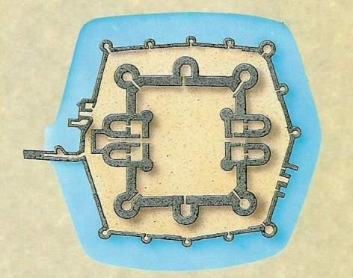
Perimeter security analogy Medieval Castle Defences
Observation posts
Outer wall
Inner wall
Guard
Inner court
Normal access
Outer
court
Bridge
Gatehouse
Moat
3

Slide 4









Defending local networks
Network Perimeter Security
External Network
Internal Network
(DMZ)
Production Servers
Work Stations
DNS
Mail Web
Server Server Server
Firewall
Firewall
Internet ^{Normal}
access
Gateway Router &
Switch
Router, Proxy
Switch
Packet Filter
Honeypot
IDS
IDS
DB
4

Slide 5
Firewalls

Slide 6





Network perimeter security method: Firewalls
A firewall is a check point that protects the internal networks against attack from outside networks
The check point decides which traffic can pass in & out based on rules
External Network Potential Threats
Internal Resources
Internet
Firewall
=
Check Point
7

Slide 7
Firewalls: Overview 1
If the risk of having a connection to the Internet is unacceptable, the most effective way of treating the risk is to avoid the risk altogether and disconnect completely.
If disconnection from the Internet is not practical, then firewalls may provide an effective level of protection that can reduce the risk to an acceptable level.
Firewalls are often the first line of defence against external attacks, but should not be the only defence.
A firewall’s purpose is to prevent unauthorized access to
or from a private network.
8

Slide 8
Firewalls: Overview 2
All traffic entering or leaving must pass through firewall
The network owner must define criteria for what is (un)authorized
The effectiveness of firewalls depends on specifying authorized traffic in terms of rules
The rules defines what to let pass through;
The rules defines what to block.
Firewalls must be effectively administered, updated with
the latest patches and monitored.
Firewalls can be implemented in both hardware and software, or a combination of both.
9

Slide 9








Types of Firewall Technology (vehicle analogy)
Inspects packet
Packet Filters
headers only
ABC123
Analyses
bi-directional traffic
Stateful Packet Filters
Application Layer Proxy
Splits connection, inspects payload, and analyses traffic
Next Generation Firewall
End-to-end connection inspects payload, and analyses traffic
10

Slide 10
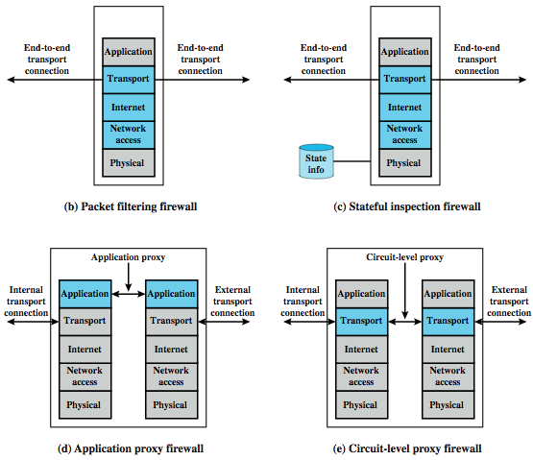
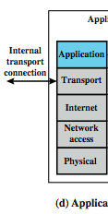
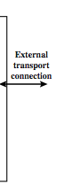
Simple Packet Filter
Types of firewalls
Stateful Packet Filter
Proxy
Next Gen. Firewall
L11: Peri
meter Security 11
Application Proxy Firewall
Next Generation Firewall

Slide 11
(Stateless) Packet Filter
A packet filter is a network router that can accept/reject packets based on headers
Packet filters examine each packet’s headers and make decisions based on attributes such as:
Source or Destination IP Addresses
Source or Destination Port Numbers
Protocol (UDP, TCP or ICMP)
ICMP message type
And which interface the packet arrived on
Unaware of session states at internal or external hosts
High speed, but primitive filter

Slide 12
(Stateless) Packet Filters
Widespread packet filter software (Linux):
iptables / netfilter
nft / nttables
Examples (iptables)
iptables -A FORWARD -s 131.234.142.33 -j ACCEPT
All packets from source IP Address 131.234.142.33 are accepted
iptables -A FORWARD -p tcp –d 10.0.0.56 --dport 22
-j ACCEPT
All packets using transport protocol and destination address
10.0.0.56 and destination port 22 are accepted

Slide 13
Problems with Stateless Filtering
Assume a typical “security policy”:
Access from internal to external allowed
Access from external to internal prohibited
Example application: home network
Naive packet filter configuration:
outgoing packet → forward
incoming packet → reject

Slide 14














Stateful Filtering
Internal Network
Internet
TCP, SYN, DST: X
TCP, SYN ACK, SRC: X
UDP, DNS Request, DST: Y UDP, DNS Response, SRC: Y
TCP, SYN, SRC: Z
UDP, DNS Response, SRC: X

Slide 15
Stateful Packet Filters
Stateful packet filters track current state of a connection
More ‘intelligent’ than simple packet filters.
Stateful packet filters keep track of sessions
Recognise if a particular packet is part of an established connection by ‘remembering’ recent traffic history.
Will add a temporary rule to allow the reply traffic back through the firewall.
When “session” is finished, the temporary rule is deleted.
This makes the definition of filtering rules easier to
accomplish and therefore potentially more secure.
High speed, can use relatively advanced filter rules
Requires memory
So can be subject to DOS (Denial of Service) attacks

Slide 16
Stateful Packet Filters
Examples (iptables)
iptables -A FORWARD -m state --state NEW
-i eth0 -j ACCEPT
Accept new connections (i.e. TCP SYN) from network interface eth0 („from inside“)
iptables -A FORWARD -m state
--state ESTABLISHED,RELATED -j ACCEPT
Accept ALL packets which belong to an established TCP connection or are related to an existing UDP communication

Slide 17
(Stateful) Packet Filter: Evaluation
Strengths:
Low overhead and high throughput
Supports almost any application
Weaknesses:
Unable to interpret application layer data/commands
may allow insecure operations to occur
Allows direct connection between hosts inside & outside firewall

Slide 18
Personal Firewalls
A personal firewall is a program that is designed to protect the computer on which it is installed
Personal firewalls are frequently used by home users to protect themselves from the Internet
Nowadays for example included in Windows
Advantage compared to network firewall: rules can take applications into account

Slide 19
IPv4 Network Address Translation (NAT)
NAT used to increase IPv4 address space
Translates public IP addr. ↔ private IP addr. and ports
Each local network can reuse private IP address ranges
Artificially increases the number of usable IP addresses
Possibilities:
Static mapping
permanent mapping of public to private address (no gain)
Dynamic mapping
mapping of public to private address when needed
unmapped when no longer needed
PAT (Port Address Translation)
multiple internal addresses mapped to same public address
but with different port numbers

Slide 20




IPv4 Network Address Translation (NAT)
public Internet |  | private network
138.76.29.7 | 5001 | 10.0.0.1 | 3345
public Internet
private network
1: host 10.0.0.1
sends datagram to
128.119.40.186, 80
2: Router changes source addr
from 10.0.0.1, 3345
to 138.76.29.7, 5001.
(Dest addr is not changed.)
S: 10.0.0.1, 3345
D: 128.119.40.186, 80
10.0.0.1
Update table.
1
2
S: 138.76.29.7, 5001
D: 128.119.40.186, 80
10.0.0.4
10.0.0.2
138.76.29.7
S: 128.119.40.186, 80
D: 10.0.0.1, 3345
4
S: 128.119.40.186, 80
D: 138.76.29.7, 5001
3
10.0.0.3
3: Reply arrives dest. address: 138.76.29.7, 5001
from 128.119.40.186, 80

Slide 21
IPv4 NAT: + & -
Advantages
Helps enforce control over outbound connections
Helps restrict incoming traffic
Helps conceal internal network configuration
Makes port scanning more difficult
Can’t be used with:
protocols that require a separate back-channel
protocols that encrypt TCP headers such as IPSec
embedded TCP address info
(Not recommended with) IPv6

Slide 22
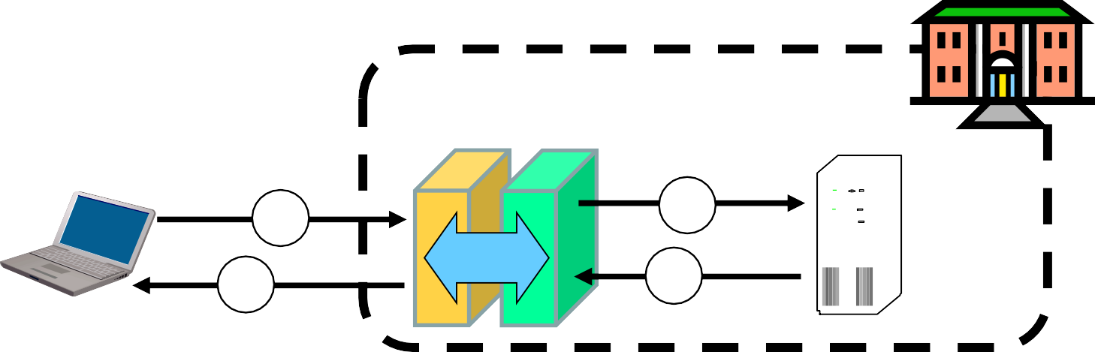

Application Layer Proxy
External client sends a request to the server, which is intercepted by the outwards-facing firewall proxy
Inwards-facing proxy sends request to server on behalf of client.
Server sends reply back to inwards-facing firewall proxy.
Outwards facing proxy sends reply to the client.
Client and server both think they communicate directly with each other, not knowing that they actually talk with a proxy.
The proxy can inspect the application data at any level of detail,
and can even modify the data
Application
Layer Firewall
Internet
Client
1
2
3
Server
Proxy
4

Slide 23



Next Generation Firewalls (NGFW)
Inspects payload in end-to-end or proxy application connection
Support specific application protocols
e.g. http, telnet, ftp, smtp etc.
each protocol supported by a specific proxy HW/SW module
Can be configured to filter specific user applications
E.g. Facebook, Youtube, LinkedIn
Can filter detailed elements in each specific user application
Can support TLS/SSL encrypted traffic inspection
Can provide intrusion detection and intrusion prevention
Very high processing load in firewall
High volume needs high performance hardware, or else will be slow

Slide 24

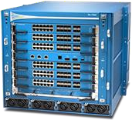
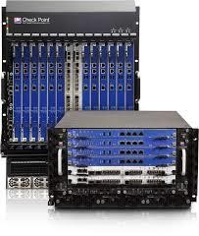

High performance NGFWs
High range model: PA-7050
Up to 120 Gbps throughput Prices starting from: US$ 200,000
High range model: 61000 Security system
Up to 400 Gbps throughput
Prices starting from: US$ 200,000

Slide 25
Inline Deep Packet Inspection
Deep Packet Inspection looks at application content instead of individual or multiple packets.
Deep inspection keeps track of application content across multiple packets.
Potentially unlimited level of detail in traffic filtering
Application parameters for e.g. Facebook
Deep Inspection
Payload Data | Payload Data | Payload Data
Packet 1
IP Header
UDP Header
Payload Data
Packet 2
IP Header
UDP Header
Payload Data
Packet 3
IP Header
UDP Header
Payload Data

Slide 26
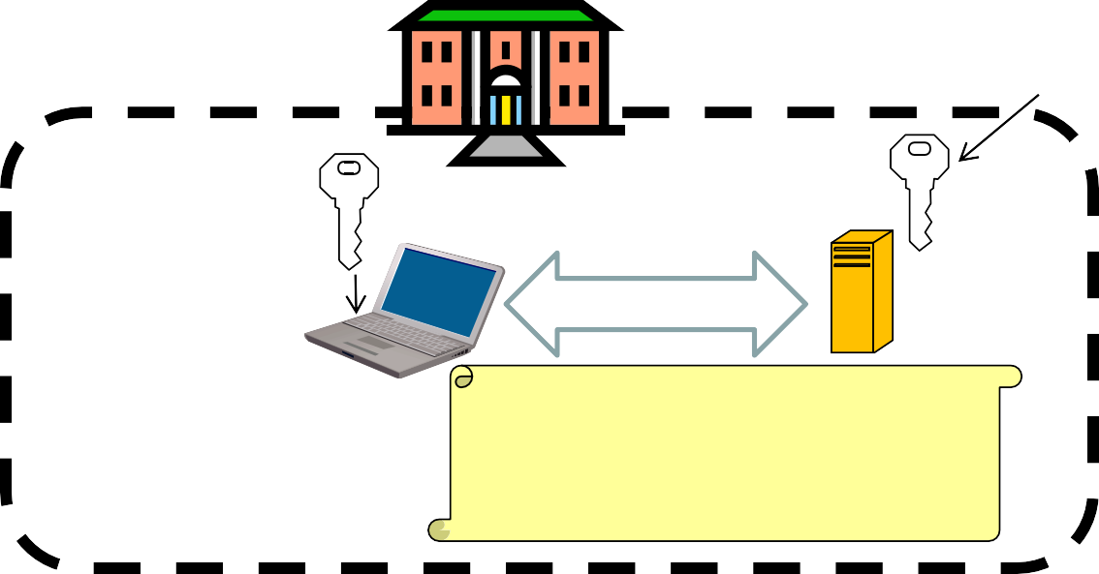





TLS/SSL encrypted traffic inspection in firewalls
TLS designed for end-to-end encryption, normally impossible to inspect
In order to inspect TLS, proxy must pretend to be external TLS server
Proxy creates proxy server certificate with the name of external server (e.g. facebook.com), signed by local proxy root private key
Assumes that local proxy root certificate is installed on all local hosts
The proxy server certificate is automatically validated by local client, so user may believe that he/she has TLS connection to the external server
Internet PKI root certificates
Proxy B
Proxy root
2
certificate
1
TLS B
TLS C
Server C
Auto-
5
4
3
^{validation Client A} Proxy cert. B, Name C,
Cert. C, Name C, signed by a CA in Internet PKI
of cert.
signed by proxy root

Slide 27




TLS inspection attack with rogue proxy server
Depending on network, attackers may be able to install rogue proxy
Rogue TLS inspect does not assume pre-installed proxy root certificate
Proxy creates fake server certificate with the name of external server (e.g. facebook.com), that e.g. can be self-signed
Fake server certificate is not validated, so browser asks user to accept it
Fake certificate has (name = domain dame), so browser sets up TLS, and user believes that he/she has TLS connection to the external server
5
Pop-up asking user to accept certificate
Internet PKI root certificate
2
Rogue proxy R
1
_{User} Accept
TLS R
7
TLS C
Server C
Cert. 6
3
Client A
8
Broken
security
4
Cert. C, Name C, signed by a CA in Internet PKI
Fake cert. R, Name C, signed by proxy R

Slide 28


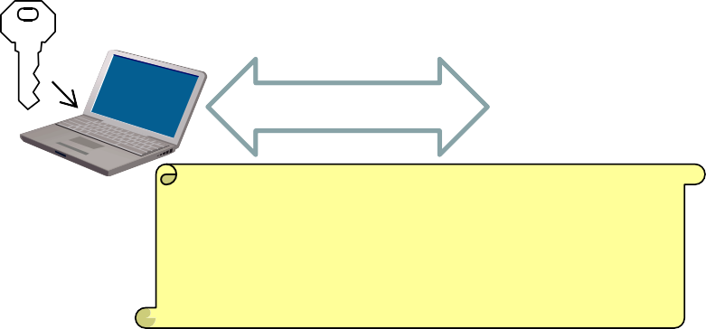

Lenovo and the Superfish scam
Superfish root certificate and diversion in shipped Lenovo models during 2014
All https connections diverted to Superfish server to inject advertisements.
Superfish created fake server certificates with names of web servers (e.g. facebook.com), signed by Superfish root private key.
Fake server certificates were automatically validated, so users believed that he/she had secure end-to-end https connection to the web server.
Scam discovered in 2015, Superfish cert. deleted and diversion removed.
Embarrassment for Lenovo. Superfish changed name to JustVisual.
Internet PKI root certificates
Superfish root certificate
1
TLS S
2
TLS C
Server C
4
^{Client A} Superfish cert, Name C,
3
5
Auto- signed by Superfish
Cert. C, Name C, signed by a CA in Internet PKI
validation
&L1^{b}1^{r}: ºP^{k}er^{e}im^{n}eter Security
security
29

Slide 29
Application Proxy Firewalls + & -
Strengths:
Easy logging and audit of all incoming traffic
Provides potential for best security through control of application layer data/commands
Weaknesses:
May require some time for adapting to new applications
Much slower than packet filters
Much more expensive than packet filters

Slide 30
Firewalls:
Simple Firewall Architecture
Internet
Router / Firewall (Gateway)
Internal Networks
Internal Networks
DNS
Server
Web
Server
Email
Server
Workstations
Production
Systems
DB
Server

Slide 31
Firewalls:
DMZ Firewall Architecture
Internet
External Router / Firewall
DMZ (Demilitarized Zone)
Production Systems
DB
Server
Workstations
Internal
Router /
Firewall
DNS
Web Email Server
Server Server
Internal Networks

Slide 32
DMZ Example
DMZ = A part of your LAN with other restrictions, e.g. allowing publicly available services (web servers, mail etc.)
Web Server
DB Server
Customer
Firewall
(External)
Firewall
(Internal)
Client
Hacker
ftp Server
Client
Hacker
External Public Network/ INTERNET
Internal Private Network / LAN
DMZ

Slide 33
Intrusion Detection Systems (IDS)

Slide 34
Intrusion Detection and Prevention
Intrusion
Actions aimed at compromising the security of a target network (confidentiality, integrity, availability of resources)
Intrusion detection
The identification of possible intrusion through intrusion
signatures and network activity analysis
IDS: Intrusion Detection Systems
Intrusion prevention
The process of both detecting intrusion activities and managing
automatic responsive actions throughout the network
IPS: Intrusion Prevention Systems
IDPS: Intrusion Detection and Prevention Systems

Slide 35
Intrusion Detection Systems:
IDS are automated systems that detect suspicious activity
IDS can be either host-based or network-based.
A host based IDS is designed to detect intrusions only on the host it is installed on
monitor changes to host’s OS files and traffic sent to the host
Network based IDS (NIDS) detect intrusions on one or more network segments, to protect multiple hosts
monitor network/s looking for suspicious traffic
What can be detected:
Attempted and successful misuse, both external and internal agents
Malware: Trojan programs, viruses and worms
DOS (Denial Of Service) attacks

Slide 36
Network IDS Deployment
External Router / Firewall
Internet
Internal Router / Firewall
DB Production Server ^{Work}
Server
Station
DMZ Network
Internal Networks
DNS
Web Email
Server
NIDS
Server Server
NIDS

Slide 37
Intrusion Detection Techniques
Misuse detection
Use attack “signatures” (need a model of the attack)
Sequences of system calls, patterns of network traffic, etc.
Must know in advance what attacker will do (how?)
Can only detect known attacks
Relatively few false positives
Anomaly detection
Using a model of normal system behavior, try to detect deviations and abnormalities
E.g., raise an alarm when a statistically rare event(s) occurs
Can potentially detect unknown attacks
Many false positives

Slide 38


Popular NIDS
Snort (popular open-source tool)
Large rule sets for known vulnerabilities, e.g.
2009-03-31: A programming error in MySQL Server may allow a remote attacker to cause a Denial of Service (DoS) against a vulnerable machine.
2009-03-27: Microsoft Windows GDI Buffer Overflow: A programming error in the Microsoft Windows kernel may allow a remote attacker to execute code with system level privileges. This may be exploited when specially crafted EMF files are viewed using Microsoft Internet Explorer.
Bro (developed by Vern Paxson)
Separates data collection and security decisions
Event Engine distills the packet stream into high-level events describing what’s happening on the network
Policy Script Interpeter uses a script defining the network’s security
policy to decide what to do in response

Slide 39
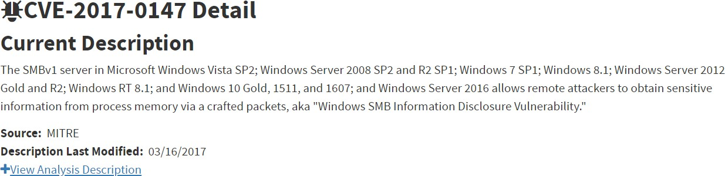
Example: Vulnerability + Snort Rule
alert tcp $HOME_NET 445 -> any any ( msg:"OS-WINDOWS Microsoft Windows SMB possible leak of kernel heap memory"; flow:to_client,established; content:"Frag",fast_pattern; content:"Free"; content:"|FA FF FF|"; content:"|F8 FF FF|",within 3,distance 5; content:"|F8 FF FF|",within 3,distance 5; metadata:policy balanced-ips alert,policy security-ips drop,ruleset community; service:netbios-ssn; reference:cve,2017-0147; reference:url,technet.microsoft.com/en-us/security/bulletin/MS17-010; classtype:attempted-recon; sid:42339; rev:2; )
40

Slide 40
Port Scanning
Many vulnerabilities are OS-specific
Bugs in specific implementations, default configuration
Port scan is often a prelude to an attack
Attacker tries many ports on many IP addresses
For example, looking for an old version of some daemon with an unpatched buffer overflow
If characteristic behavior detected, mount attack
“The Art of Intrusion”: virtually every attack involves port scanning and password cracking
slide 41

Slide 41
Port Scanning
Example: network services on a Windows computer
Proto. | Local Address | Foreign Address | State
TCP | 0.0.0.0:80 | 0.0.0.0:0 | LISTEN
TCP | 0.0.0.0:135 | 0.0.0.0:0 | LISTEN
TCP | 0.0.0.0:445 | 0.0.0.0:0 | LISTEN
TCP | 0.0.0.0:554 | 0.0.0.0:0 | LISTEN
TCP | 0.0.0.0:623 | 0.0.0.0:0 | LISTEN
TCP | 0.0.0.0:2869 | 0.0.0.0:0 | LISTEN
TCP | 0.0.0.0:5357 | 0.0.0.0:0 | LISTEN
TCP | 0.0.0.0:10243 | 0.0.0.0:0 | LISTEN
TCP | 0.0.0.0:16992 | 0.0.0.0:0 | LISTEN
TCP | 0.0.0.0:49152 | 0.0.0.0:0 | LISTEN
TCP | 0.0.0.0:49153 | 0.0.0.0:0 | LISTEN
TCP | 0.0.0.0:49154 | 0.0.0.0:0 | LISTEN
TCP | 0.0.0.0:49155 | 0.0.0.0:0 | LISTEN
TCP | 0.0.0.0:49157 | 0.0.0.0:0 | LISTEN
TCP | 0.0.0.0:56238 | 0.0.0.0:0 | LISTEN
42

Slide 42
Intrusion Detection Problems
Lack of training data with real attacks
But lots of “normal” network traffic, system call data
Data drift
Statistical methods detect changes in behavior
Attacker can attack gradually and incrementally
Discriminating characteristics hard to specify
Many attacks may be within bounds of “normal” range of activities
False identifications are very costly
Sysadm will spend many hours examining evidence
slide 43

Slide 43
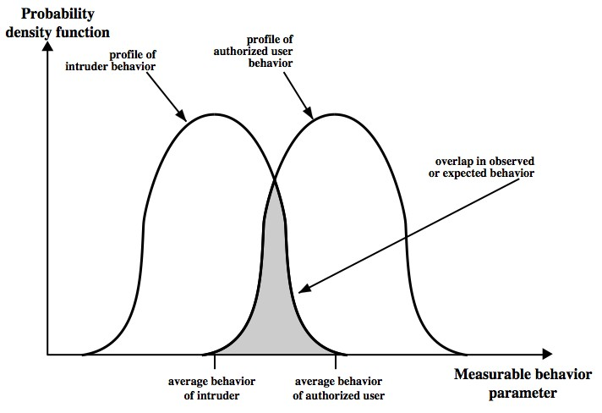
44

Slide 44
Intrusion Detection Errors
False negatives: attack is not detected
Big problem in signature-based misuse detection
False positives: harmless behavior is classified as attack
Big problem in statistical anomaly detection
Both types of IDS suffer from both error types
Both false positives and false negatives are problematic
Attacks are fairly rare events
IDS often suffer from “base-rate fallacy”
slide 45

Slide 45
Base Rate Fallacy
Consider statements:
A: “attack occurs”
D: “detection occurs”
We can measure/estimate:
P(D|A): probability of detection, given that attack occurs
P(D|!A): probability of detection, given that no attack occurs
P(A): probability of attack
We want to know (false/true positives):
P(A|D): probability of attack, given that detection triggers
Bayes theorem:
₌ 𝑃(𝐷|𝐴)∙𝑃(𝐴)
𝑃(𝐷|𝐴)∙𝑃(𝐴)
– 𝑃 𝐴 𝐷
=
𝑃(𝐷)
𝑃(𝐷|𝐴)∙𝑃(𝐴)+𝑃(𝐷|!𝐴)∙𝑃(!𝐴)

Slide 46
Base Rate Fallacy
Example:
Scanner is 99% correct: P(D | A) = 0.99, P(D | !A) = 0.01
Attack probability: P(A) = 1 / 10000
𝑃 𝐴 𝐷 =
Result:
0.99∙0.0001
= 0.010098
0.99∙0.0001+0.01∙0.9999
1% accuracy
99 false positives per true positives

Slide 47
Remarks on Intrusion Detection
Most alarms are false positives
Requires automated screening and filtering of alarms
Most true positives are trivial incidents
can be ignored,
the attacks will never be able to penetrate any system
Serious incidents need human attention
Can be dealt with locally
May require external expertise
Potential for improvement through more intelligent IDS
Less false positives
Better detection of advanced attacks (APT)

Slide 48
Intrusion Prevention Systems
Intrusion Prevention System (IPS) is a relatively new term that can mean different things
Most commonly, an IPS is a combination of an IDS and a firewall
A system that detects an attack and can stop it as well
Can be application specific
– Deployed on a host to stop attacks on specific applications such as IIS
Can be an extension of an NIDS
False positives are problematic, because automated prevention measures can block services
50

Slide 49

Honeypots
A honeypot:
is a computer configured to detect network attacks or malicious behavior,
appears to be part of a network, and seems to
contain information or a resource of value to attackers.
But honeypots are isolated, are never advertised and are continuously monitored
All connections to honeypots are per definition malicious
Can be used to extract attack signatures
Honeynet is an international security club, see next slide
slide 51

Slide 50
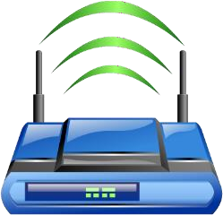
WLAN Security

Slide 51



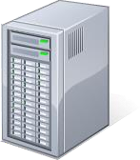

IEEE 802.11 Standards for WLAN
IEEE 802.11 formed in 1990’s
charter to develop a protocol & transmission specifications for wireless LANs (WLANs)
Since then the demand for WLANs, at different frequencies and data rates, has exploded
New ever-expanding list of standards issued
from 10Mbps to 1Gbps transmission rate
Wireless Station (STA)
WiFi
Security
Internet
Access Point
(AP)

Slide 52
802.11 WiFi Security
Only authorized terminals (or users) may get access through Wireless LAN
Should be impossible to set up rogue AP
Interception of traffic by radios within range should be impossible
 | WEP (1999) 801.11b | WPA (2003) 802.11i (subset) | WPA2 (2004) (aka. RSN) 802.11i (full set)
Auth. & key gen. | WEP | EAP | EAP
Encryption | RC4 | RC4+TKIP | CCMP AES CTR (or TKIP)
WEP: Wired Equivalent Privacy (broken)
WPA: WiFi Protected Access
EAP: Extensible Authentication Protocol
RC4: Rivest Cipher 4 (a stream cipher)
TKIP: Temporal-Key Integrity Protocol
CCMP: Counter Mode with CBC Message Authentication Protocol
RSN: Robust Security Network

Slide 53
IEEE 802 Terminology
Station (STA)
Wireless terminal that communicates with 802.11 functionality
Access Point (AP)
Receives radio signals and controls access to network
Basic Service Set (BSS)
Set of stations and one AP
Extended Service Set (ESS)
Set of multiple BSSs
Distribution System (DS)
Contains an Authentication Server (AS)
Integrates multiple BSSs into one ESS

Slide 54
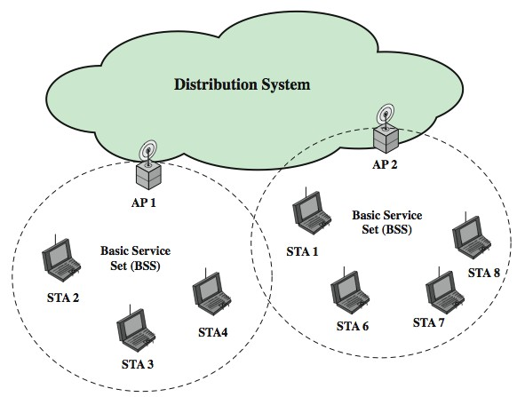
Network Components & Architecture

Slide 55
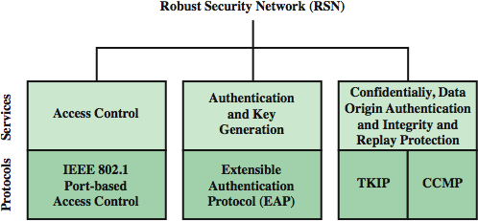
802.11i RSN Services and Protocols

Slide 56
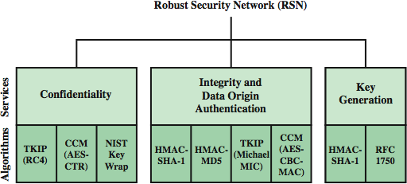
802.11i RSN Cryptographic Algorithms

Slide 57
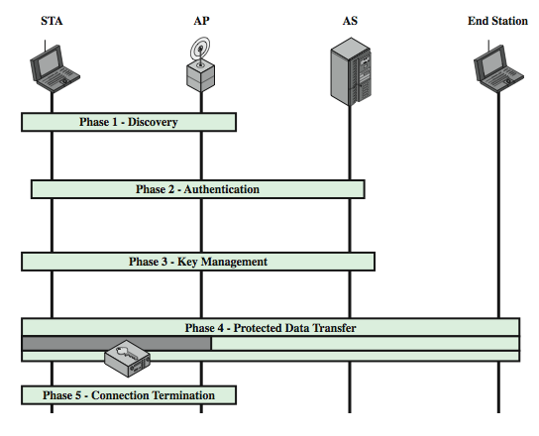
802.11i Phases of Operation
L
11: Perimeter Security 59

Slide 58
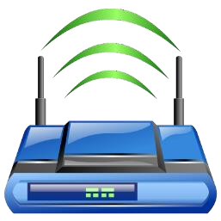


802.11i WiFi Access Control
Mutual identity request between STA and AP
Mutual authentication between STA and AS.
Derive pairwise master key (PMK) between STA and AP.
Encrypt radio link and open port (connect) to network access
Controlled port from AP to network
is closed (disconnected) before authentication
is open (connected) after successful authentication
Access Point (AP)
Authentication Server
(AS)
1
Always open port
2
3
2
Wireless Station (STA)
4
4
Controlled port
Switch
Local Network & Internet

Slide 59
When you don’t control the WLAN
Often you want to connect to a wireless LAN over which you have no control, e.g. in café
Options:
If you can, connect securely (WPA2, 802.11i, etc.)
Beware of SSL-stripping
If unsecured, connect to online resources securely:
Use a VPN (Virtual Private Network)
IPSEC connection to home gateway
TLS/SSL connections to secure web server (with HSTS)
Be careful not to expose passwords
Watch for direct attacks on untrusted networks

Slide 60
End of Lecture
This lecture presented:
Firewall techniques
Intrusion detection techniques
WLAN Access

